Slide 1
Closed Form Solution

Slide 2
Different approaches to Linear Regression
OLS (Ordinary least squares) goal is to find the best-fitting line (hyperplane) that minimizes the vertical offsets, which can be mean squared error (MSE) or other error metrics (MAE, RMSE) between the target variable and the predicted output.
We can implement a linear regression model using the following approaches:
Solving model parameters (closed-form equations)
Using optimization algorithm (gradient descent, stochastic gradient, etc.)

Slide 3
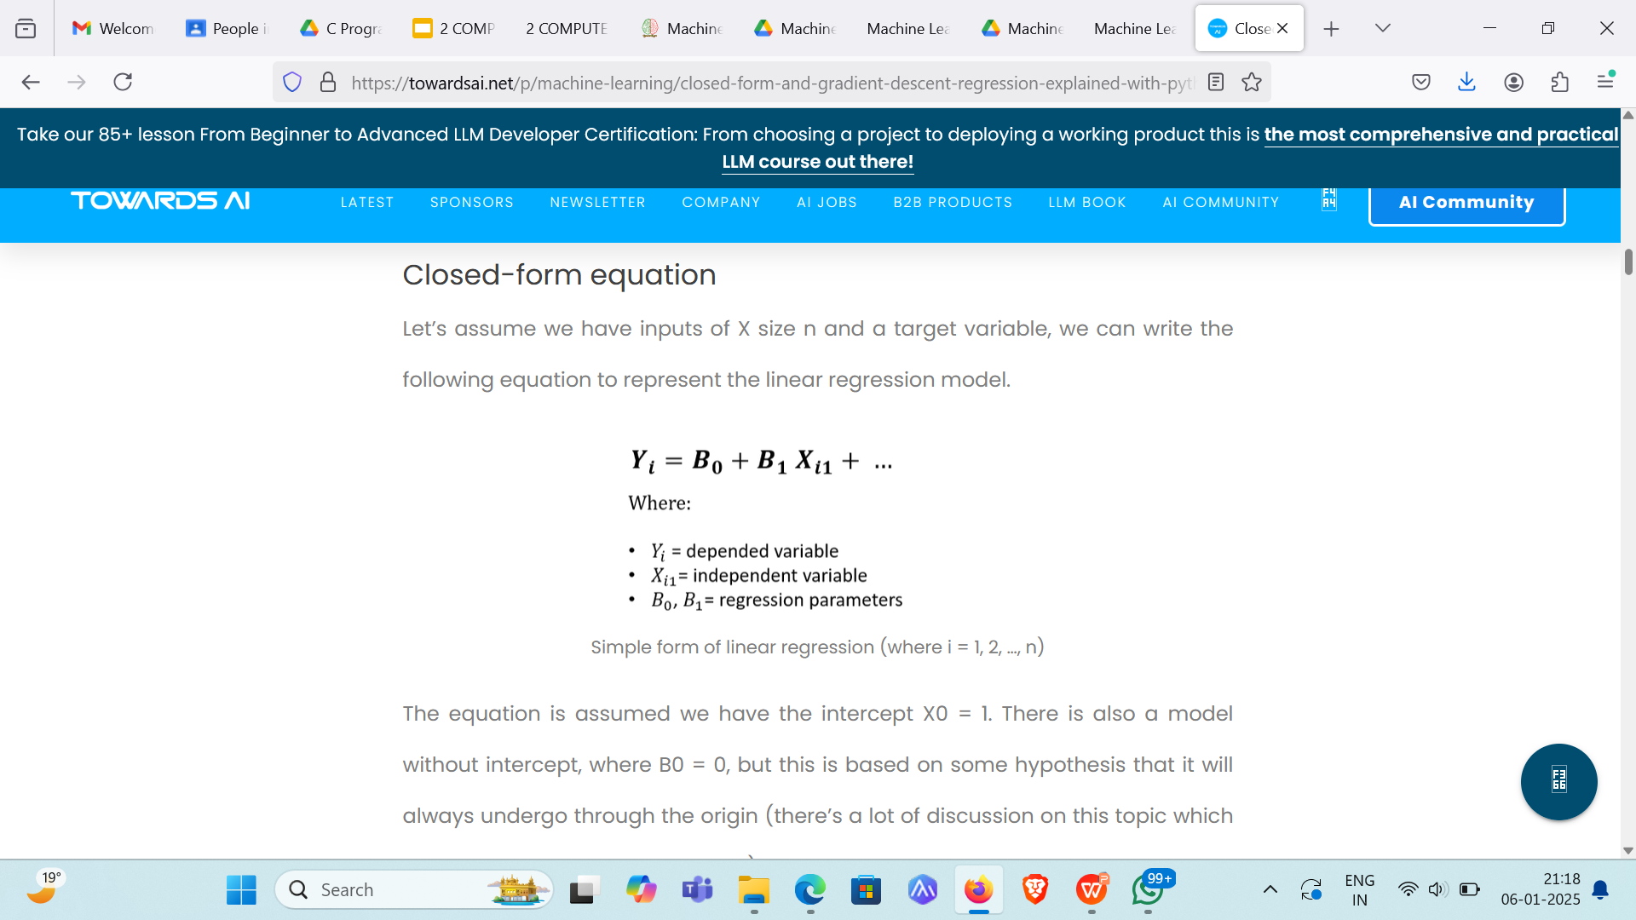
Closed-form equation

Slide 4
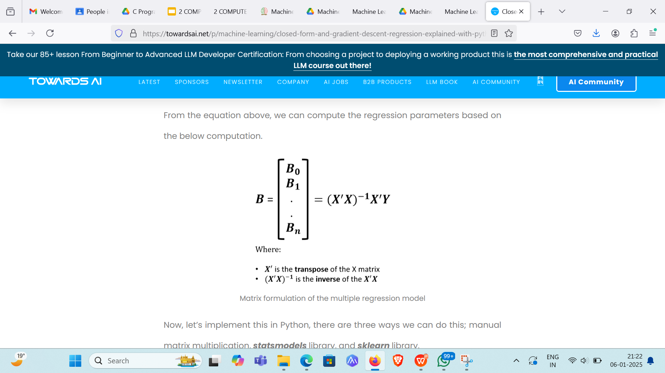
Closed-form equation(contd.)
This approach offers a better solution for smaller data, easy, and quick explainable model.

Slide 5
Gradient Descent
Why we need gradient descent if the closed-form equation can solve the regression problem. There will be some situations which are;
There is no closed-form solution for most nonlinear regression problems.
Even in linear regression, there may be some cases where it is impractical to use the formula. An example is when X is a very large, sparse matrix. The solution will be too expensive to compute.

Slide 6
Gradient Descent(contd.)
Gradient descent is an optimization algorithm used to minimize some cost function by repetitively moving in the direction of steepest descent. Hence, the model weights are updated after each epoch.

Slide 7
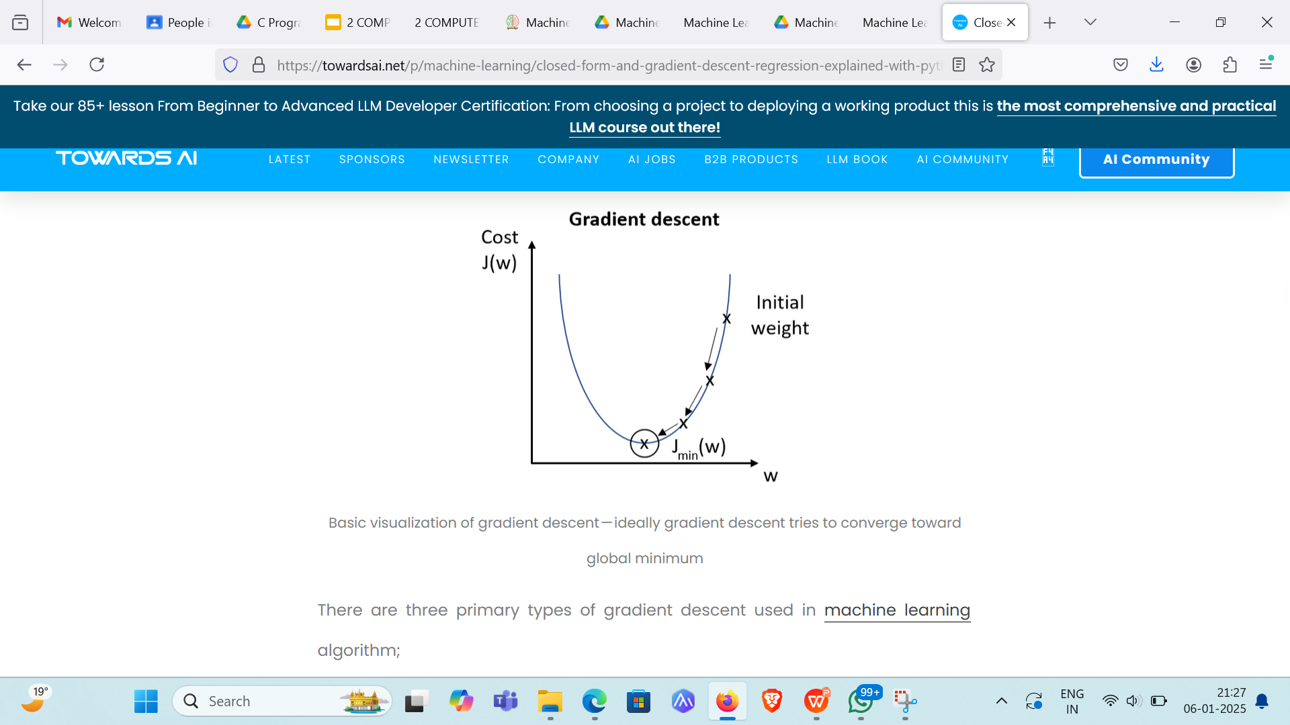
Gradient Descent(contd.)

Slide 8
There are three primary types of gradient descent used in machine learning algorithm;
Batch gradient descent
Stochastic gradient descent
Mini-batch gradient descent

Slide 9
Batch Gradient Descent
This approach is the most straightforward. It calculates the error for each observation within the training set. It will update the model parameters after all training observations are evaluated. This process can be called a training epoch.

Slide 10
The main advantages of this approach are computationally efficient and producing a stable error gradient and stable convergence, however, it requires the entire training set in memory, also the stable error gradient can sometimes result in the not-the-best model (converge to local minimum trap, instead attempt to find the best global minimum).

Slide 11
Stochastic Gradient Descent
In stochastic gradient descent, SGD (or sometimes referred to as iterative or online GD). The name “stochastic” and “online GD” come from the fact that the gradient-based on single training observation is a “stochastic approximation” of the true cost gradient. However, because of this, the path towards the global cost minimum is not direct and may go up-and-down before converging to the global cost minimum.

Slide 12
Hence;
This makes SGD faster than batch GD (in most cases).
We can view the insight and rate of improvement of the model in real-time.
Increased model update frequency can result in faster learning.
Noisy update of stochastic nature can help to avoid the local minimum.

Slide 13
However, some disadvantages are;
Due to update frequency, this can be more computation expensive, which can take a longer time to complete than another approach.
The frequent updates will result in a noisy gradient signal, which causes the model parameters and error to jump around, higher variance over training epochs.

Slide 14
Mini-Batch Gradient Descent
Mini-batch gradient descent (MB-GD) is a more preferred method since it compromises between Batch gradient descent and stochastic gradient descent. It separates the training set into small batches and feeds to the algorithm. The model will get updates based on these batches. The model will converge more quickly than batch GD because the weights get updated more frequently.

Slide 15
This method combines the efficiency of batch GD and the robustness of stochastic GD. One (small) downside is this method introduces a new parameter “batch size”, which may require the fine-tuning as part of model tuning/optimization.

